Slide 1



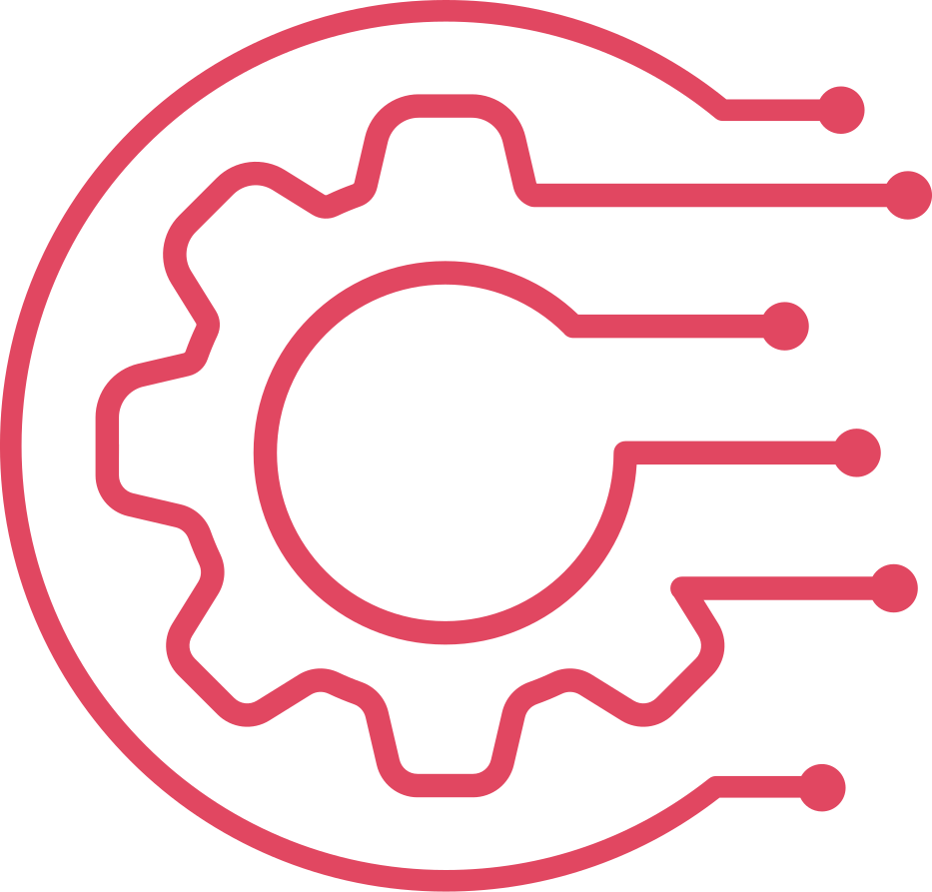

S D K H O L A
Programming in Java
Java Features
First Sample Program
Java Virtual Machine(JVM) Architecture
Difference between JDK, JRE, and JVM [Home Assignment]

Slide 2
S D K H O L A
Why a new Programming Language is Developed?
Computer language innovation and development occurs for these reasons:
To adapt to changing environments and uses.
To implement refinements and improvements in the art of programming.
The development of Java was driven by both elements in nearly equal measure.
Enable the development of portable, High-Performance Applications for the widest range of Computing platforms possible

Slide 3
S D K H O L A
The Creation of Java
James Gosling (Father of Java), Mike Sheridan, and Patrick Naughton initiated the Java language project in June 1991. The small team of sun engineers called Green Team.
Java is an island of Indonesia where the first coffee was produced (called java coffee). It is a kind of espresso bean. Java name was chosen by James Gosling while having coffee near his office.
JDK 1.0 released in(January 23, 1996). After the first release of Java, there have been many additional features added to the language.
By the end of the 1980s and the early 1990s, object-oriented programming using C++ took hold.
Indeed, for a brief moment it seemed as if programmers had finally found the perfect language.
Because C++ blended the high efficiency and stylistic elements of C with the object oriented paradigm, it was a language that could be used to create a wide range of programs.
Within a few years, the World Wide Web (www) and the Internet would reach critical mass.
This event would precipitate another revolution in programming.

Slide 4
S D K H O L A
Java - Versions
Many Java versions have been released till now. The current stable release of Java is Java SE 18.
JDK Alpha and Beta (1995)
JDK 1.0 (23rd Jan 1996)
SE 3 JDK 1.1 (19th Feb 1997)
J2SE 1.2 (8th Dec 1998)
J2SE 1.3 (8th May 2000)
J2SE 1.4 (6th Feb 2002)
J2SE 5.0 (30th Sep 2004)
Java SE 6 (11th Dec 2006)
Java SE 7 (28th July 2011)
Java SE 8 (LTS) (18th Mar 2014)
Java SE 9 (21st Sep 2017)
Java SE 10 (20th Mar 2018)
Java SE 11 (LTS) September 2018
Java SE 12 March 2019
Java SE 13 September 2019
Java SE 14 March 2020
Java SE 15 September 2020
Java SE 16 March 2021
Java SE 17 (LTS) September 2021
Java SE 18 March 2022
UPCOMING -
Java SE 19 September 2022
Java SE 20 March 2023
Java SE 21 (LTS) September 2023

Slide 5








S D K H O L A
The Creation of Java - Applications
According to Sun, 3 billion devices run Java. There are many devices where Java is currently used. Some of them are as follows:
Desktop/Standalone/Window Applications such as acrobat reader, media player, antivirus, etc.
Web Applications such as irctc.co.in, javatpoint.com, etc.
Enterprise Applications such as banking applications.
Mobile
Embedded System
Robotics
Smart Card
Add a little bit of body text
The Creation of Java - Platforms/Editions
There are 4 platforms or editions of Java:
Java SE (Java Standard Edition)
It is a Java programming platform. It includes Java programming APIs such as java.lang, java.io, java.net, java.util, java.sql, java.math etc.
It includes core topics like OOPs, String, Regex, Exception, Inner classes, Multithreading, I/O Stream, Networking, AWT, Swing, Reflection, Collection, etc.
Java EE (Java Enterprise Edition)
It is an enterprise platform which is mainly used to develop web and enterprise applications.
It is built on the top of the Java SE platform. It includes topics like Servlet, JSP, Web Services, EJB, JPA, etc.
Java ME (Java Micro Edition)
It is a micro platform which is mainly used to develop mobile applications.
JavaFX
It is used to develop rich internet applications. It uses a light-weight user interface API.

Slide 6
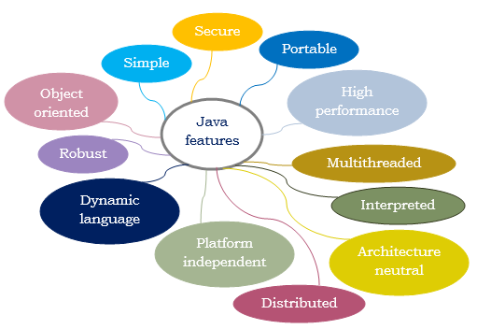
S D K H O L A
Features of Java (The Java Buzzwords)

Slide 7
S D K H O L A
Features of Java (The Java Buzzwords)
Object Oriented: Java is an object-oriented programming language.
Everything in Java is an object.
Object-oriented means we organize our software as a combination of different types of objects that incorporates both data and behavior.
OOPs is a methodology that simplifies software development and maintenance by providing some rules.
Basic concepts of OOPs are:
Object , Class , Inheritance , Polymorphism , Abstraction , Encapsulation
Simple: Java is very easy to learn, and its syntax is simple, clean and easy to understand.
Java syntax is based on C/C++ (so easier for programmers to learn it after C++).
Java has removed many complicated and rarely-used features, for example, explicit pointers, operator overloading, etc.
There is no need to remove unreferenced objects because there is an Automatic Garbage Collection in Java.
Platform Independent: Java is a write once, run anywhere language.
Java code is compiled by the compiler and converted into bytecode (language like C, C++, which are compiled into platform specific machines).
The bytecode is a platform-independent code because it can be run on multiple platforms.
There are two types of platforms software-based and hardware-based. Java provides a software?based platform that runs on the top of other hardware-based platforms. It has two components:
JRE (Java Runtime Environment)
API (Application Programming interface)

Slide 8
Secured: Java is best known for its security. With Java, we can develop virus-free systems.
Java is secured because:
No explicit pointer Classloader
Java Programs run inside a virtual machine sandbox (C/C++ uses runtime environment of OS)
Bytecode Verifier: It checks the code fragments for illegal code that can violate access right to objects.
Security Manager: It determines what resources a class can access such as reading and writing to the local disk.
Robust: Robust simply means strong. Java is robust because:
Automatic garbage collection in java
Exception handling: In a well-written Java program, all run-time errors can—and should—be managed by your program.
There is a lack of pointers that avoids security problems.
Architecture-neutral: Java is architecture neutral because:
No implementation dependent features, for example, the size of primitive types is fixed.
It occupies 4 bytes of memory for both 32-bit and 64-bit architectures in Java.
Operating system upgrades, processor upgrades, and changes in core system resources can all combine to make a program malfunction.
The goal of Java designer was “Write once; run anywhere, any time, forever.” To a great extent, this goal was accomplished.
Interpreted and High-performance:
This code can be executed on any system that implements the Java Virtual Machine.
The Java bytecode is translated directly into native machine code for very high performance by using a just-in-time compiler.
Java run-time systems that provide this feature lose none of the benefits of the platform-independent code.
S D K H O L A

Slide 9
S D K H O L A
Multithreaded: We can write Java programs that deal with many tasks at once by defining multiple threads.
A thread is like a separate program, executing concurrently.
The main advantage of multi-threading is that it doesn't occupy memory for each thread. It shares a common memory area.
Threads are important for multi-media, Web applications, etc.
Java was designed to meet the real-world requirement of creating interactive, networked programs.
Distributed: Java is distributed because it facilitates users to create distributed applications in Java.
RMI and EJB are used for creating distributed applications.
This feature of Java makes us able to access files by calling the methods from any machine on the internet.
Java is designed for the distributed environment of the Internet because it handles TCP/IP protocols.
Dynamic: Java is a dynamic language.
It supports dynamic loading of classes. It means classes are loaded on demand.
It also supports functions from its native languages, i.e., C and C++.
Java supports dynamic compilation and automatic memory management (garbage collection).

Slide 10
S D K H O L A
The First Sample Program
// This is a simple Java Program
class HelloWorld{
public static void main(String args[ ]) {
System.out.println("Hello World");
}
}
Comment - Describes how the program works or what a specific feature does.
The contents of a comment are ignored by the compiler.
class - The keyword class is used to define/create a new class.
HelloWorld - HelloWorld is an identifier that is the name of the class.
public -The keyword public is an access modifier (visibility specifier).
Regulate access to classes, fields and methods in Java.
static -The keyword static allows main( ) to be called without creating object of the class.
This is necessary since main( ) is called by the Java Virtual Machine before any objects are made
void - The keyword void simply tells the compiler that main( ) does not return a value.
main( ) - The main( ) method is the starting point for JVM to start execution of a Java program.
Without the main() method, JVM will not execute the program.
String args[ ] -The parameter args is used to receive any command
line arguments when the program is executed.
System is a predefined class that provides access to the system 4 9 System.out - out is the output stream that is connected to the console(terminal window).
println( ) - The bulit-in println( ) method displays the string which is passed to it.
Other important information - A complex program will have dozens of classes, only one of which will need to have a main( ) method to get things started. Other important information In some cases, you won’t need main( ) at all. For example, when creating applets. All statements in Java end with a semicolon.

Slide 11
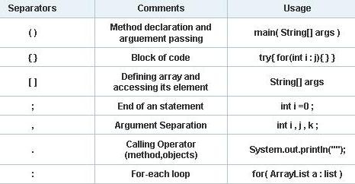
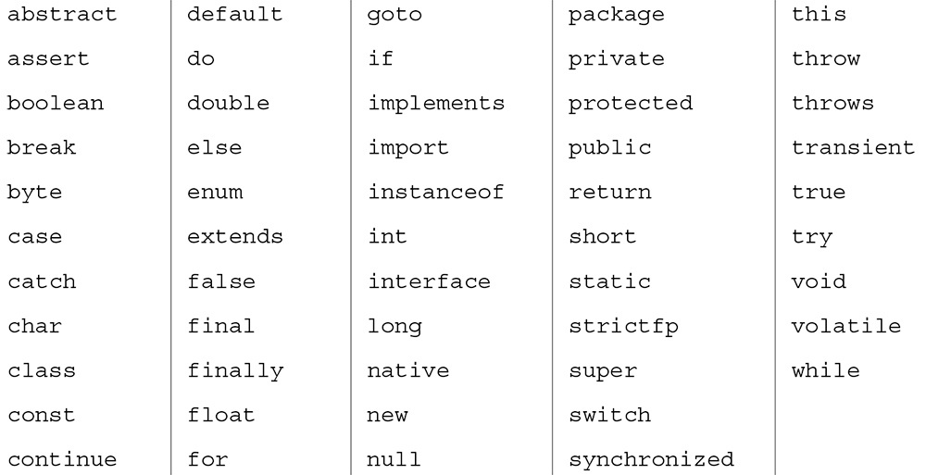
S D K H O L A
Saparators
Keywords
JVM Architecture -
The JVM performs following operation: Loads code , Verifies code , Executes code , Provides runtime environment
JVM provides definitions for the: Memory Area , Class file format , Register Set , Garbage-collected heap , Fatal error reporting etc.

Slide 12
S D K H O L A
JVM Architecture
Classloader - Classloader is a subsystem of JVM which is used to load class files.
Whenever we run the java program, it is loaded first by the classloader.
Class(Method) Area - Class(Method) Area stores per-class structures such as the runtime constant pool, field and method data, the code for methods.
Heap - It is the runtime data area in which objects are allocated.
Stack -It holds local variables and partial results, and plays a part in method invocation and return.
A new frame is created each time a method is invoked. A frame is destroyed when its method invocation completes.
PC Register - PC (program counter) register contains the address of the Java virtual machine instruction currently being executed.
Native Method Stack - It contains all the native methods used in the application.
Execution Engine contains: A virtual processor.
Interpreter: Read bytecode stream then execute the instructions.
Just-In-Time(JIT) compiler: helps improve the performance of Java programs by compiling bytecodes into native machine code at run time.
Java Native Interface : Java Native Interface (JNI) is a framework which provides an interface to communicate with application written in C, C++, Assembly etc. Java uses JNI framework to send output to the Console or interact with OS libraries.

Slide 13
S D K H O L A
Facts about Java :
Java was called Oak at the beginning. The original name for Java was Oak.
It was just an accident! ...
Second most popular language.
Most popular user interface.
Final is not final in Java.
You are paid to learn Java.
A Java developer’s median salary is $83, 975.00. It pays to be a Java developer.
In one year Java gets downloaded one billion times.
Minecraft Was First Written in Java.
There are over 9 million Java developers across the Earth.
In java there is total 67 keywords , 16 of them are only contextually reserved, and can sometimes be used as an identifier, unlike standard reserved words.
Oracle Corporation is the current owner of the official implementation of the Java SE platform, following their acquisition of Sun Microsystems on January 27, 2010.
James Gosling is founder of Java.
Java was first released in 1995.
JDK 1.0 was released on January 23, 1996. After the first release of Java.
There is no Full form of JAVA.

Slide 14

S D K H O L A
THANK YOU
S D K H O L A

